Slide 1
Announcements
Midterm 2:
3/20, 8-10 PM in various rooms.
Covers material through 3/16 (next Friday).
Study using study guides.
THE KEY IS METACOGNITION: Reflect on your problem solving strategies and those of your fellow students.
Understanding a handful of solutions to old midterm problems is less helpful than you might think -- look at answers as late as possible.
There is an alternate 61C midterm from 6 - 8 in 1 LeConte.

Slide 2
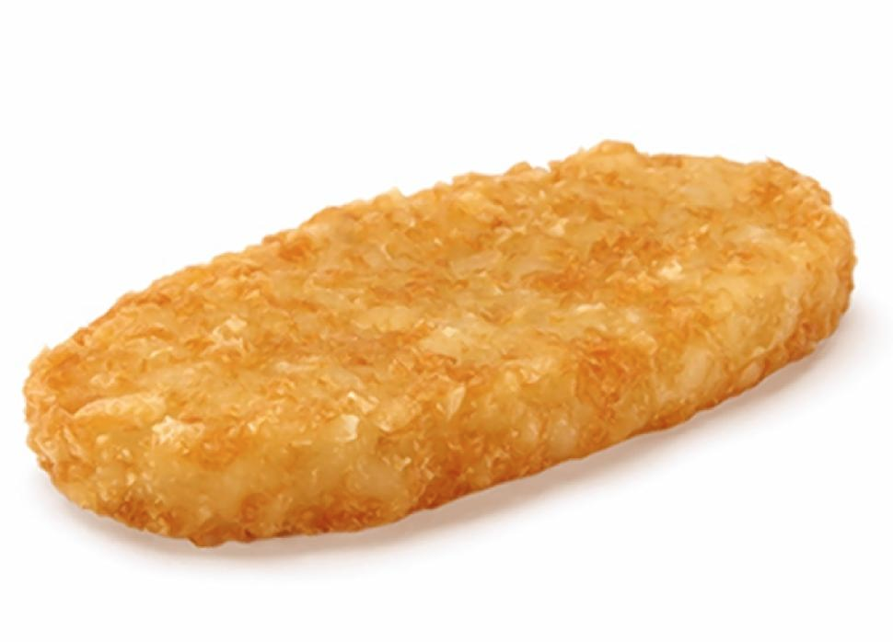
CS61B
Lecture 23: Hashing
Set Implementations, DataIndexedIntegerSet
Binary Representations, DataIndexedSet
Handling Collisions
Hash Functions

Slide 3
Techniques for Storing Data: Ordered Linked List
A
B
C
D
E
F
G
contains
insert
 | contains(x) | insert(x)
Linked List | Θ(N) | Θ(N)
Worst case runtimes

Slide 4
Techniques for Storing Data: Bushy BST
k
e
v
b
g
p
y
a
d
f
j
m
r
x
z
contains
insert
Limitations:
Items must be comparable.
Maintaining bushiness is non-trivial.
Θ(log N), can we do better?
Note: log is pretty good. One billion items yields tree height of only 30.
 | contains(x) | insert(x)
Linked List | Θ(N) | Θ(N)
Bushy BSTs | Θ(log N) | Θ(log N)
Worst case runtimes

Slide 5
Techniques for Storing Data: Unordered Array
a
z
f
j
r
d
x
m
contains
insert
 | contains(x) | insert(x)
Linked List | Θ(N) | Θ(N)
Bushy BSTs | Θ(log N) | Θ(log N)
Unordered Array | Θ(N) | Θ(N)
Unordered arrays are terrible (and so are ordered ones).
But a third type of array...
Worst case runtimes

Slide 6
Using data as an Index
One extreme approach: All data is really just bits.
Use data itself as an array index.
Store true and false in the array.
T
0
1
2
3
4
5
6
7
8
9
10
11
12
13
14
15
F
F
F
F
T
Downsides of this approach (that we can maybe fix):
Extremely wasteful of memory. To support checking presence of all positive integers, we need 2 billion booleans.
Need some way to generalize beyond integers.
F
F
F
F
T
T
DataIndexedIntegerSet diis = new DataIndexedIntegerSet();
diis.insert(0);
diis.insert(5);
diis.insert(10);
diis.insert(11);
F
F
F
F
...
Set containing 0, 5, 10, 11

Slide 7
DataIndexedIntegerSet Implementation
public class DataIndexedIntegerSet {
boolean[] present;
public DataIndexedIntegerSet() {
present = new boolean[16];
}
public insert(int i) {
present[i] = true;
}
public contains(int i) {
return present[i];
}
}
T
0
1
2
3
4
5
6
7
8
9
10
11
12
13
14
15
F
F
F
F
T
F
F
F
F
T
T
F
F
F
F
...
Set containing 0, 5, 10, 11

Slide 8
DataIndexedIntegerSet Implementation
public class DataIndexedIntegerSet {
boolean[] present;
public DataIndexedIntegerSet() {
present = new boolean[100000];
}
public insert(int i) {
present[i] = true;
}
public contains(int i) {
return present[i];
}
}
 | contains(x) | insert(x)
Linked List | Θ(N) | Θ(N)
Bushy BSTs | Θ(log N) | Θ(log N)
Unordered Array | Θ(N) | Θ(N)
DataIndexedArray | Θ(1) | Θ(1)
Worst case runtimes

Slide 9
Binary Representations
DataIndexedSet

Slide 10
Generalizing the DataIndexedIntegerSet Idea
Suppose we want to insert(“cat”)
The key question:
What is the catth element of an array?
One idea: Use the first letter of the word as an index.
What’s wrong with this approach?
0 never changes (so a tiny bit of wasted space).
Other words start with c.
contains(“chupacabra”) : YES
Can’t store “=98yae98fwyawef”
0
1
2
3
4
a
b
c
d
F
F
F
T
F
...

Slide 11
Refined Approach
Treat the string as a n-digit base 27 number.
c: 3rd letter of alphabet, a: 1st letter, t: 20th letter
Thus the index of “cat” is 3 * 27² + 1 * 27 + 20
Why this specific pattern?
Let’s review how numbers are represented in decimal.
0
1
2234
F
F
...
T
...

Slide 12
The Decimal Number System
In the decimal number system, we have 10 digits: 0, 1, 2, 3, 4, 5, 6, 7, 8, 9
Want numbers larger than 9? Use a sequence of digits.
Example: 7091 in base 10
7091₁₀ = (7 x 10³) + (0 x 10²) + (9 x 10¹) + (1 x 10⁰)

Slide 13
Binary (Base 2)
In the binary number system, we have two digits: 0, 1.
Want larger numbers than 1? Use a sequence of digits.
Example: What is 1110₂ in base 10?
1110₂ = (1 x 2³)+ (1 x 2²) + (1 x 2¹) + (0 x 2⁰) = (8)+ (4) + (2) + (0)
= 14₁₀
Base 10 | Base 8 | Base 2
0 | 0 | 0
1 | 1 | 1
2 | 2 | 10
3 | 3 | 11
4 | 4 | 100
5 | 5 | 101
6 | 6 | 110
7 | 7 | 111
8 | 10 | 1000
9 | 11 | 1001

Slide 14
Binary (Base 2): Larger Example
Suppose we have the 32 bit binary number below.
What is it decimal? Sum the 2nd, 4th, 5th, 10th, and 11th powers of 2.
00 00000 00000 00000 00011 00001 10100
2¹¹
2¹⁰
2⁵
2²
2⁴
(1 x 2¹¹)+ (1 x 2¹⁰) + (1 x 2⁵) + (1 x 2⁴) + (1 x 2²)
= (2048) + (1024) + (32) + (16) + (4)
= 3124₁₀

Slide 15
Generalizing to Words
There are many ways to represent cat.
Base 27: Our approach before: cat → 3 * 27² + 1 * 27 + 20 = 2234
F
0
1
2234
F
...
00 00000 00000 00000 00010 00101 11010
2234
T
Why does this work? Multiplying by 32 is equivalent to shifting right by 5 places.
Base 32: 3 * 32² + 1 * 32 + 20 = 3124
Nice feature: Each letter is exactly 5 bits. Good for lecture.
F
0
1
3124
F
00 00000 00000 00000 00011 00001 10100
3124
...
c
a
t
T
3
1
20

Slide 16
Generalizing to Words
Suppose we’re storing multiple words.
Convert each word to unique integer representation.
As on previous slide: Use 5 bits per letter.
example: “cat” becomes 3124.
c: 3rd letter of alphabet, a: 1st, t: 20th
0
1
3124
4583
20382827
524555300
553256591
553256592
F
F
...
Equivalent to treating like a base 32 number.
T
...
00 00000 00000 00000 00011 00001 10100
T
...
c
a
t
T
DataIndexedWordSet diws = new DataIndexedWordSet();
diws.put("cat");
diws.put("dog");
diws.put("potato");
diws.put("snack");
...
3124
4583
553256591
20382827
F
...
T
F
...

Slide 17
Generalizing to Words
What about longer strings? Have to tolerate either:
A maximum string (seems lame).
Ambiguity: e.g. “hothead” vs. “pothead”.
Both represented by 523878693
Switching to base 27 from 32 won’t save us (more soon).
0
1
3124
4583
20382827
524555300
553256591
553256592
F
F
...
T
...
T
...
00 01111 10100 01000 00101 00001 00100
T
...
o
t
h
e
a
d
bottom bits of p
bottom bits of h
F
hothead?
pothead?
othead?
...
T
F
...

Slide 18
DataIndexedWordSet Implementation
F
0
1
3124
4583
20382827
524555300
553256591
553256592
F
public void insert(String s) {
int intRep = convertToInt(s);
present[intRep] = true;
}
public boolean contains(String s) {
int intRep = convertToInt(s);
return present[intRep];
}
...
T
...
T
...
T
...
F
...
T
F
...

Slide 19
DataIndexedWordSet Implementation
F
0
1
3124
4583
20382827
524555300
553256591
553256592
/** Converts ith character of String to a letter number.
* e.g. 'a' -> 1, 'b' -> 2, 'z' -> 26 */
public static int letterNum(String s, int i) {
int ithChar = s.charAt(i);
if ((ithChar < 'a') || (ithChar > 'z'))
{ throw new IllegalArgumentException();
return ithChar - 'a' + 1;
}
public static int convertToInt(String s) {
int intRep = 0;
for (int i = 0; i < s.length(); i++) {
intRep = intRep << 5; // same as intRep * 32;
intRep = intRep + letterNum(s, i);
}
return intRep;
}
F
...
T
...
T
...
T
...
F
...
T
F
...

Slide 20
DataIndexedArray
Two fundamental challenges:
How do we resolve ambiguity (“grosspie” vs. “bosspie”)?
We’ll call this collision handling.
How do we convert arbitrary data to an index?
We’ll call this computing a hashCode.
For Strings, this was relatively straightforward (treat as a base 27 or base 32 number).
Note: Java requires that EVERY object provide a method that converts itself into an integer: hashCode()
More on what makes a good hashCode() later.
0
1
3124
4583
20382827
524555300
553256591
553256592
F
F
...
T
...
T
...
T
...
F
...
T
F
...

Slide 21

Hat Giveaway

Slide 22
Handling Collisions

Slide 23
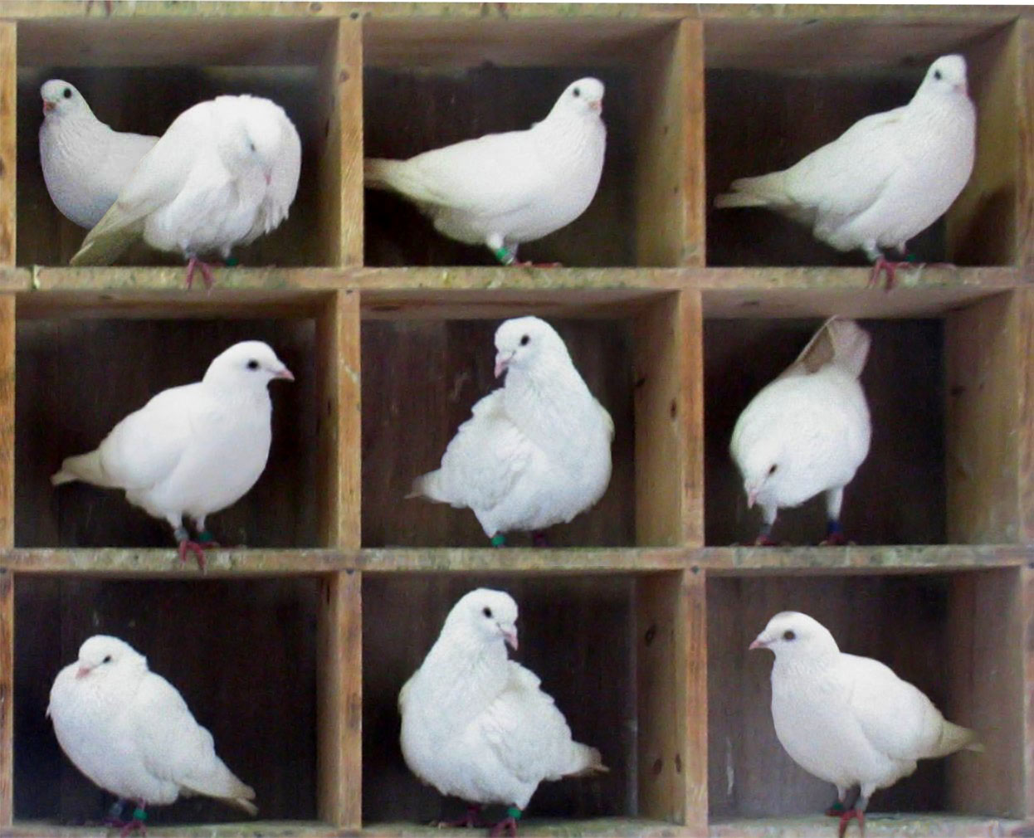
Resolving Ambiguity
Biggest array in Java is 2 billion entries.
Pigeonhole principle tells us that if there are more than 2 billion possible items, multiple items will share the same box.
Example: More than 2 billion possible Planets.
Each has mass, xPos, yPos, xVel, yVel, imgName.
Example: More than 2 billion possible strings.
“one”, “two”, … “four billion and six”, ...

Slide 24
Resolving Ambiguity
Pigeonhole principle tells us that if there are more than 2 billion possible things, multiple items will share the same box.
Suppose N items have the same hashcode h:
Instead of storing true in position h, store a list of these N items at position h.
How to implement list?
Easiest way: Linked list.
But any list would do (ArrayList, etc.)
(... if you wanted, could use a set instead)

Slide 25
External Chaining
External Chaining: Storing all items that map to h in a linked list.
0
1
3124
4583
20382827
553256591
553256592
Worst case time | contains(x) | insert(x)
Linked List | Θ(N) | Θ(N)
Bushy BSTs | Θ(log N) | Θ(log N)
Unordered Array | Θ(N) | Θ(N)
External Chaining | Θ(Q) | Θ(Q)
...
cat
...
dog
...
Why Q and not 1?
snack
...
Q: Length of longest list
potato
rotato
totato

Slide 26
External Chaining
Observation: We don’t really need 2 billion buckets.
0
1
3124
4583
20382827
553256591
553256592
Q: If we use the 10 buckets on the right, where should our six items go?
...
cat
0
1
2
3
4
5
6
7
8
9
...
dog
...
snack
...
potato
rotato
totato

Slide 27
External Chaining
Observation: Can use modulus of hashcode to reduce bucket count.
0
1
3124
4583
20382827
553256591
553256592
Q: If we use the 10 buckets on the right, where should our six items go?
Put in bucket = hashCode % 10
...
cat
0
1
2
3
4
5
6
7
8
9
...
potato
rotato
totato
dog
dog
...
cat
snack
...
snack
potato
rotato
totato

Slide 28
External Chaining Performance
Depends on the number of items in the ‘bucket’.
If N items are distributed across M buckets, average time grows with N/M = L, also known as the load factor.
Average runtime is Θ(L).
0
1
2
3
4
5
Load factor: 11/6 = 1.83
Obvious observation: If L is small, our data structure will be very fast.
Question: As N grows, what can we do to ensure that L stays small?

Slide 29




Array Resizing: http://yellkey.com/skin
Whenever L=N/M exceeds some number, increase M by resizing.
Question: In which bin will the apple appear after resizing?
hashCode() of axe
16
20
0
1
2
3
4
5
0
1
2
3
13
7
Load factor: 4/4 = 1
Load factor: 4/6 = 0.667

Slide 30
Array Resizing
Whenever L=N/M exceeds some number, increase M by resizing.
Question: In which bin will the apple appear after resizing?
16
20
0
1
2
3
4
5
7
13
0
1
2
3
13
20
7
16
Load factor: 4/4 = 1
Load factor: 4/6 = 0.667
7 % 6 = 1

Slide 31
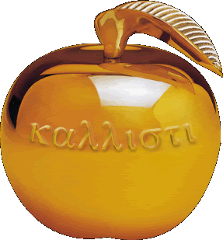
Using Negative .hashCodes: http://yellkey.com/medical
Suppose that .hashCode() returns -1.
Philosophically, into which bucket is it most natural to place this item?
0
1
2
3

Slide 32
Using Negative .hashCodes
Suppose that .hashCode() returns -1.
Philosophically, into which bucket is it most natural to place this item?
I say 3, since -1 → 3, 0 → 0, 1 → 1, 2 → 2, 3 → 3, 4 → 0, ...
0
1
2
3
-1

Slide 33
Using Negative .hashCodes in Java
Suppose that .hashCode() returns -1.
Unfortunately, -1 % 4 = -1. Will result in index errors!
Use Math.floorMod instead.
public class ModTest {
public static void main(String[] args) {
System.out.println(-1 % 4);
System.out.println(Math.floorMod(-1, 4));
}
}
0
1
2
3
$ java ModTest
-1
3

Slide 34
Hash Table Definition and Key Implementation Details
This data structure we’ve designed is called a hash table:
Every item is mapped to a bucket number using a hash function.
Typically, computing hash function consists of two steps:
Computing a hashCode (integer between -2³¹ and 2³¹ - 1).
Computing index = hashCode modulo M.
If L = N/M gets too large, increase M.
If multiple items map to the same bucket, we have to resolve ambiguity somehow. Two common techniques:
External Chaining (creating a list for each bucket, the technique we just used).
Open Addressing (a little stranger, not necessarily better, see extra slides).
May come up at job interviews.
Be careful, negative numbers % M won’t work.

Slide 35
External Chaining Performance
Assuming items are spread out (e.g. not all in the same bucket):
0
1
2
3
4
Average case time | contains(x) | insert(x)
External Chaining, Fixed Size | Θ(L) | Θ(L)
External Chaining With Resizing | Θ(L) | Θ(L)
Balanced BST | Θ(log N) | Θ(log N)
0
1
2
3
4
56
7
8
 | Load Factor L
External Chaining, Fixed Size | Θ(N)
External Chaining With Resizing | Θ(1)
Amortized!

Slide 36
One Last Little Detail
Performance depends on the number of items in each ‘bucket’.
Given load factor of N/M.
Average runtime is Θ(L).
Average isn’t the whole story. Want balanced buckets. Analogous to maintaining bushiness in a BST, but conceptually much easier to solve.

Slide 37
Hash Functions

Slide 38
What Makes a good .hashCode()?
Goal: We want hash tables that look like the table on the right.
Want a hashCode that spreads things out nicely on real data.
Example #1: return 0 is a bad hashCode function.
Example #2: Our convertToInt function for strings was bad. Top bits were ignored, e.g. “potato” and “give me a potato” have same hashCode.
Writing a good hashCode() method can be tricky.

Slide 39
Example: String hashCode function
Our convertToInt function:
h(s) = (s₀ - ’a’ + 1) × 32^{n-1} + (s₁ - ‘a’ + 1) × 32^{n-2} + … + (s_{n-1} - ‘a’ + 1)
Problems:
Intended for lower case strings only.
Top bits are totally ignored.

Slide 40
Example: String hashCode function
Improved convertToInt function:
h(s) = s₀ × 32^{n-1} + s₁ × 32^{n-2} + … + s_{n-1}
Problems:
Intended for lower case strings only: Fix by removing - ‘a’
Top bits are totally ignored.
Why? Because multiplying by 32 is equivalent to left shifting by 5 bits. Result: Top characters get pushed out completely.
How can we fix?

Slide 41
Example: String hashCode function
Java’s actual hashCode() function for Strings:
h(s) = s₀ × 31^{n-1} + s₁ × 31^{n-2} + … + s_{n-1}
Problems:
Intended for lower case strings only: Fix by removing - ‘a’
Top bits are totally ignored.
Why? Because multiplying by 32 is equivalent to left shifting by 5 bits. Result: Top characters get pushed out completely.
How can we fix: Multiply by powers of 31!
In convertToInt, we tried to have the kth character contribute to specific bits of the hashCode(). Nice for understanding lecture, but exactly the wrong idea for avoiding hashCode collisions!

Slide 42
Example: String hashCode Function Example
Java’s hashCode() function:
h(s) = s₀ × 31^{n-1} + s₁ × 31^{n-2} + … + s_{n-1}
Consider ‘cat’:
Food for thought: Hash tables with a number of buckets equal to a multiple of 31 will not work very well with this hashCode(). Why?
convertToInt()
00 00000 00000 00000 00011 00001 10100
c
a
t
95139
‘c’
00000000 01100011
*31²
00 00000 00000 00010 11100 11101 00011
3007
‘a’
00000000 01100001
*31
00 00000 00000 00000 00010 11101 11111
116
‘t’
00000000 01110100
*1
00 00000 00000 00000 00000 00011 10100
Why these numbers? ASCII
98262
00 00000 00000 00010 11111 11110 10110

Slide 43
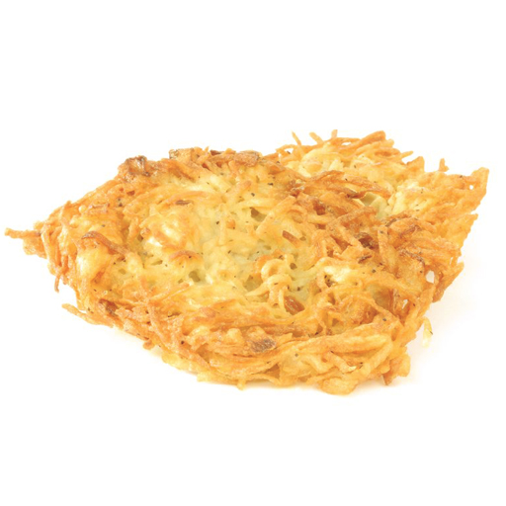
Hashing
How do you make hashbrowns?
Chopping potato into nice predictable segments? No way!
This is a hashbrown:
Notes:
https://cookingplanit.com/public/uploads/inventory/hashbrown_1366322674.jpg

Slide 44
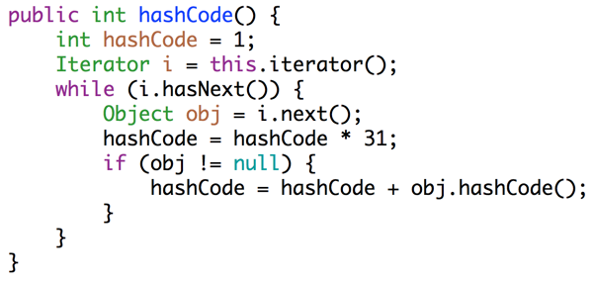
Example: Hashing a Collection
Lists are a lot like strings: Collection of items each with its own hashCode:
To save time hashing: Look at only first few items.
Higher chance of collisions but things will still work.
@Override
public int hashCode() {
int hashCode = 1;
for (Object o : this) {
hashCode = hashCode * 31;
hashCode = hashCode + o.hashCode();
}
return hashCode;
}
elevate/smear the current hash code
add new item’s hash code

Slide 45
Example: Hashing a Recursive Data Structure
Computation of the hashCode of a recursive data structure involves recursive computation.
For example, binary tree hashCode (assuming sentinel leaves):
@Override
public int hashCode() {
if (this.value == null) {
return 0;
}
return this.value.hashCode() +
31 * this.left.hashCode() +
31 * 31 * this.right.hashCode();
}

Slide 46
Default hashCodes()
All Objects have hashCode() function.
Default: returns this (i.e. address of object).
Can have strange consequences: “hello”.hashCode() is not the same as (“h” + “ello”).hashCode()
Can override for your type.
Hash tables (HashSet, HashMap, etc.) are so important that Java requires that all objects implement hashCode().

Slide 47
HashSets and HashMaps
Java provides a hash table based implementation of sets and maps.
Idea is very similar to what we’ve done in lecture.
Warning: Never store mutable objects in a HashSet or HashMap!
Warning #2: Never override equals without also overriding hashCode.
Why these warnings? See study guide.
In lab 9, you’ll get a chance to implement a hash map.

Slide 48
Summary
With good hashCode() and resizing, operations are Θ(1) amortized.
No need to maintain bushiness (but still need good hashCode).
Store and retrieval does not require items to be comparable.
 | contains(x) | insert(x)
Linked List | Θ(N) | Θ(N)
Bushy BSTs | Θ(log N) | Θ(log N)
Unordered Array | Θ(N) | Θ(N)
Hash Table | Θ(1) | Θ(1)
Used by: TreeSet
Used by: HashSet,
Python dictionaries
Worst case runtimes

